Slide 1
Multi-Objective Optimization Problems
with Well-Conditioned Solutions
Harshal Bharat Dupare
18MA20015
Supervised by
Dr. Geetanjali Panda
Department of Mathematics
Indian Institute of Technology, Kharagpur
Harshal Bharat Dupare, 18MA20015
Masters Thesis Project’s Presentation, 2nd May 2023

Slide 2
Motivation and Definition Literature Review
Addressing cond-fMOOP Observations and Methodology Experimental Results Conclusion and Future Work
Table of Contents
Motivation and Definition
Literature Review
Addressing cond-fMOOP
Observations and Methodology
Experimental Results
Conclusion and Future Work
Harshal Bharat Dupare, 18MA20015
Masters Thesis Project’s Presentation, 2nd May 2023

Slide 3

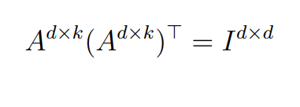
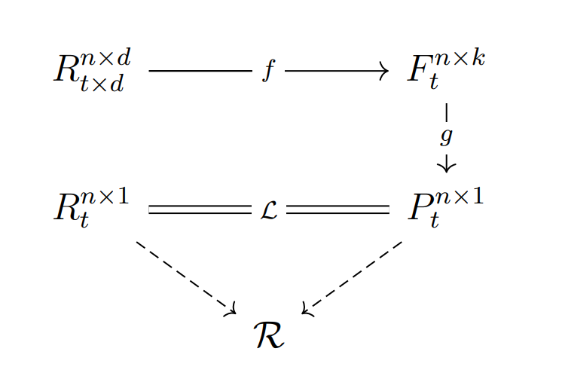
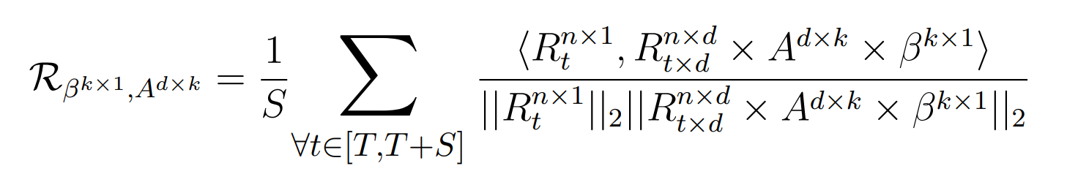
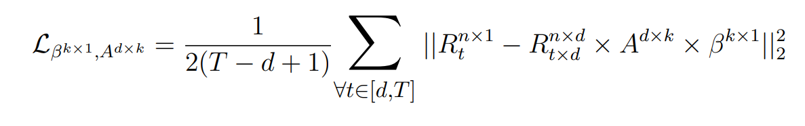
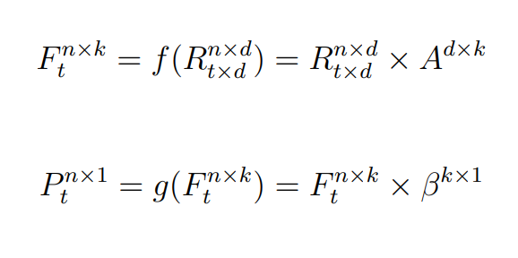
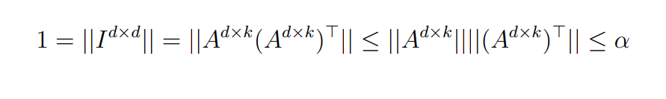
Motivation and Definition Literature Review
Addressing cond-fMOOP Observations and Methodology Experimental Results Conclusion and Future Work
Motivating Problem
Definitions
Generalization
Other Applications
Motivating Problem
Harshal Bharat Dupare, 18MA20015
Masters Thesis Project’s Presentation, 2nd May 2023

Slide 4
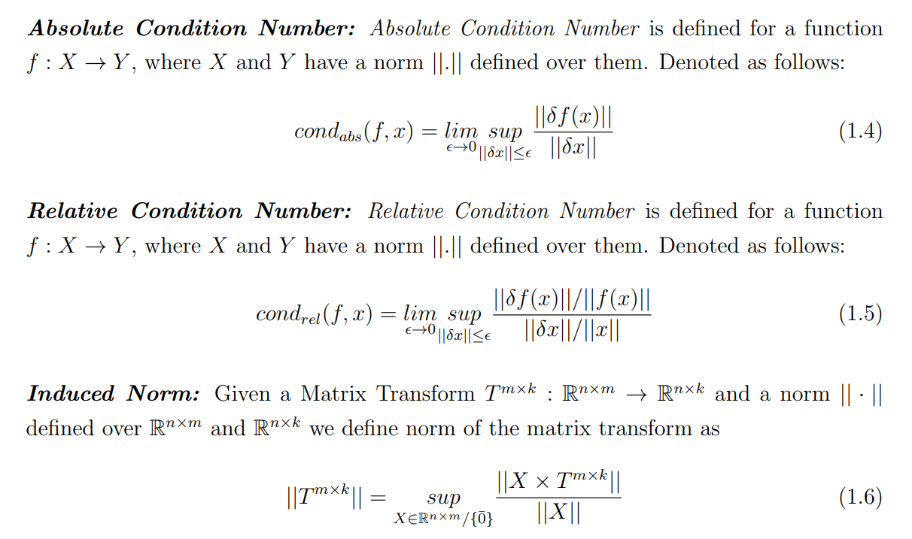
Motivation and Definition Literature Review
Addressing cond-fMOOP Observations and Methodology Experimental Results Conclusion and Future Work
Motivating Problem
Definitions
Generalization
Other Applications
Definitions
Harshal Bharat Dupare, 18MA20015
Masters Thesis Project’s Presentation, 2nd May 2023

Slide 5
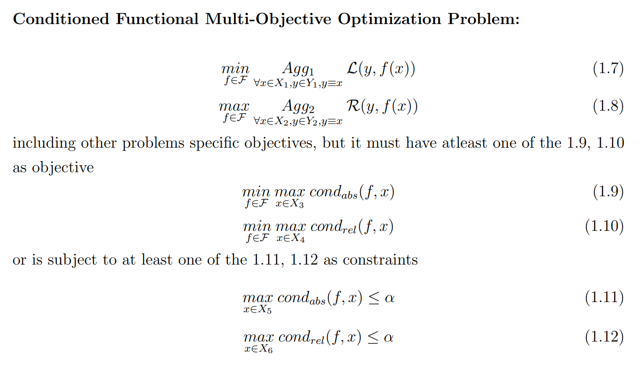
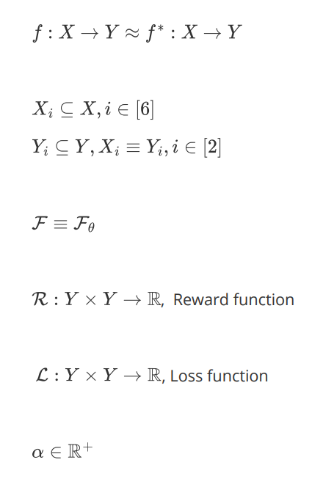
Motivation and Definition Literature Review
Addressing cond-fMOOP Observations and Methodology Experimental Results Conclusion and Future Work
Motivating Problem
Definitions
Generalization
Other Applications
Generalization
Harshal Bharat Dupare, 18MA20015
Masters Thesis Project’s Presentation, 2nd May 2023

Slide 6
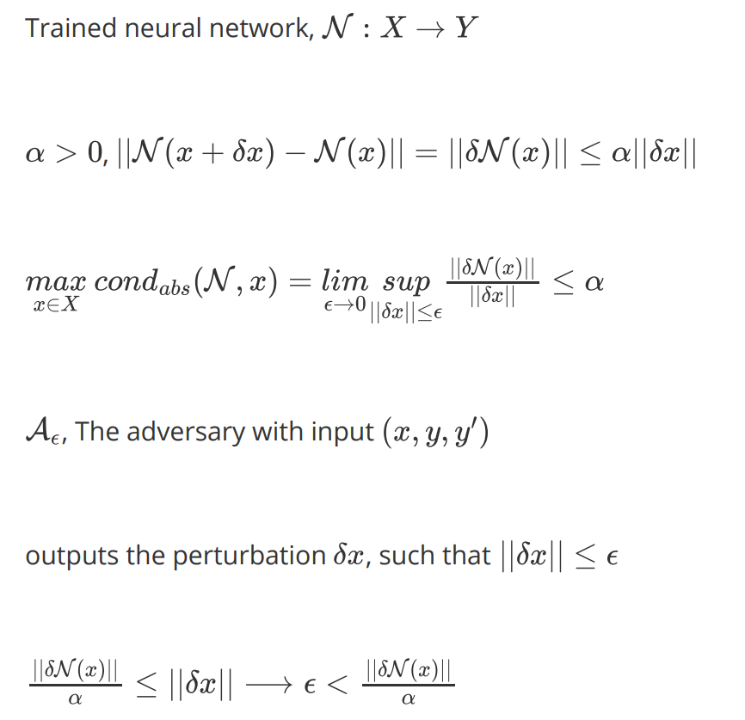
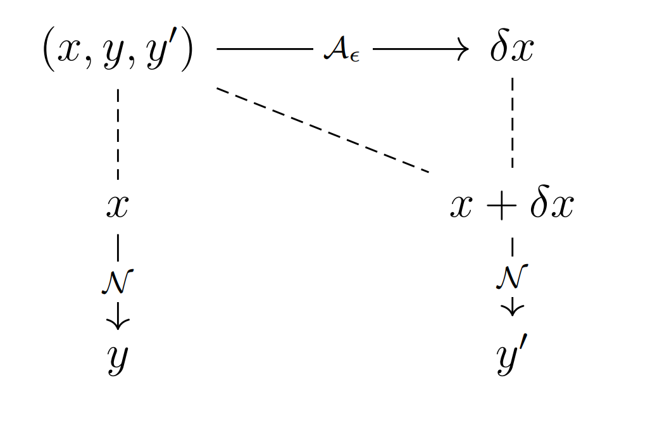
Motivation and Definition Literature Review
Addressing cond-fMOOP Observations and Methodology Experimental Results Conclusion and Future Work
Motivating Problem
Definitions
Generalization
Other Applications
Other Applications
Harshal Bharat Dupare, 18MA20015
Masters Thesis Project’s Presentation, 2nd May 2023

Slide 7
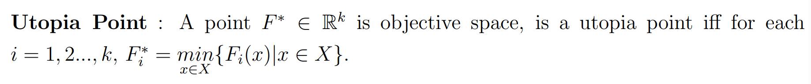

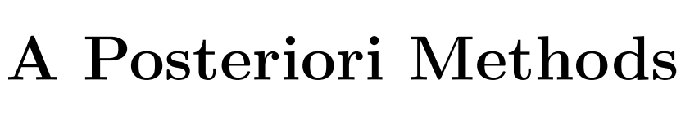
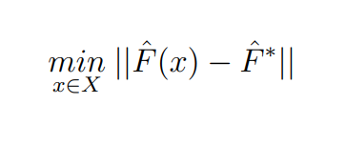
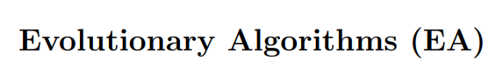

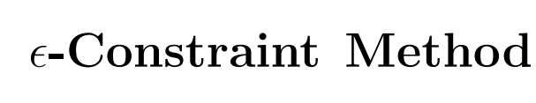
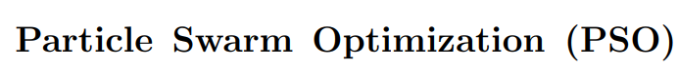
Motivation and Definition Literature Review
Addressing cond-fMOOP Observations and Methodology Experimental Results Conclusion and Future Work
Multi-Objective Optimization Methods
Findings on Condition Number
Multi-Objective Optimization Methods
Harshal Bharat Dupare, 18MA20015
Masters Thesis Project’s Presentation, 2nd May 2023

Slide 8
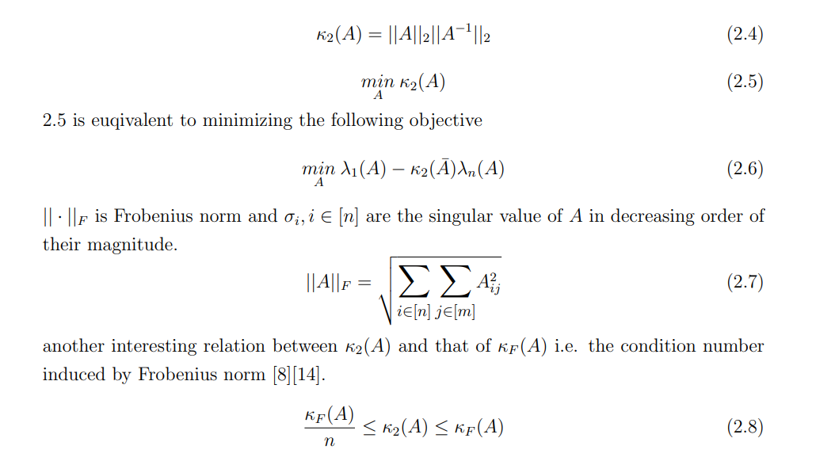
Motivation and Definition Literature Review
Addressing cond-fMOOP Observations and Methodology Experimental Results Conclusion and Future Work
Multi-Objective Optimization Methods
Findings on Condition Number
Findings on Condition Number
Pierre Maréchal and Jane J. Ye in their paper Optimizing Condition Numbers. They also proved that that the problem of minimizing the condition number is non-smooth and non-convex optimization problem.
Harshal Bharat Dupare, 18MA20015
Masters Thesis Project’s Presentation, 2nd May 2023

Slide 9
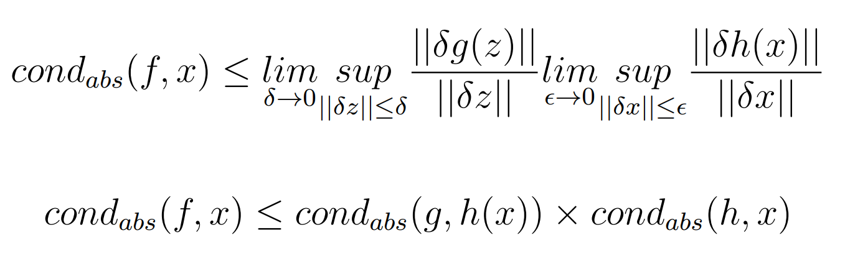
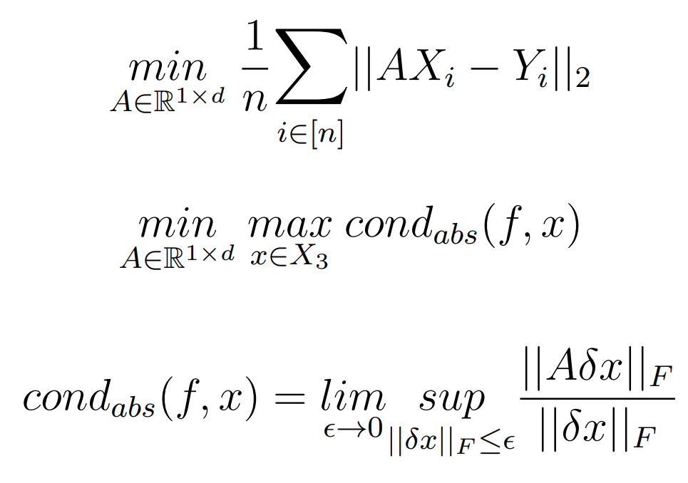
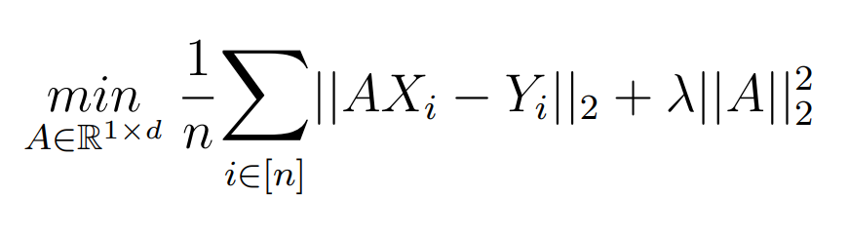
Motivation and Definition Literature Review
Addressing cond-fMOOP Observations and Methodology Experimental Results Conclusion and Future Work
Theoretical Results
Questions on cond-fMOOP
Theoretical Results
Harshal Bharat Dupare, 18MA20015
Masters Thesis Project’s Presentation, 2nd May 2023

Slide 10
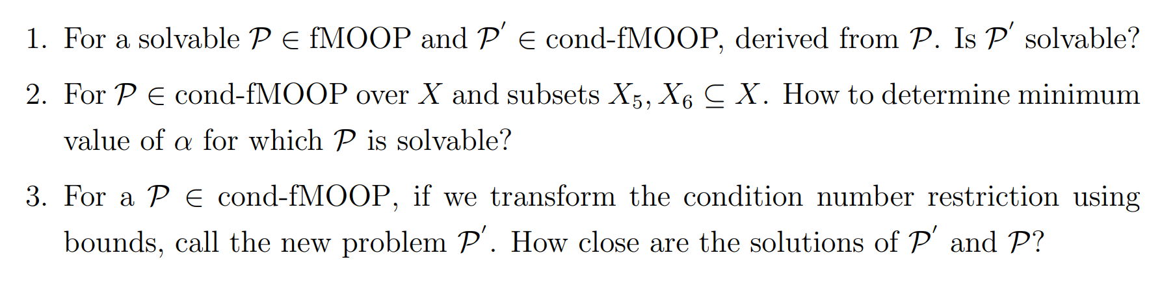
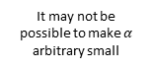
Motivation and Definition Literature Review
Addressing cond-fMOOP Observations and Methodology Experimental Results Conclusion and Future Work
Theoretical Results
Questions on cond-fMOOP
Questions on cond-fMOOP
fMOOP
fMOOP
cond-fMOOP
It may not be possible to make $α$ arbitrary small
Knowing the difference
Harshal Bharat Dupare, 18MA20015
Masters Thesis Project’s Presentation, 2nd May 2023

Slide 11
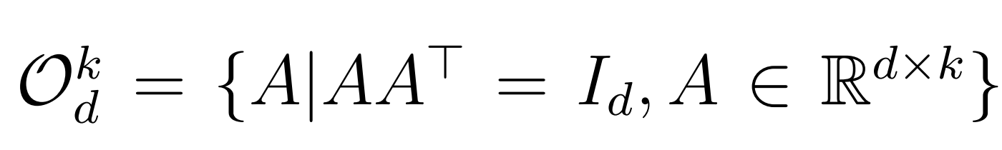
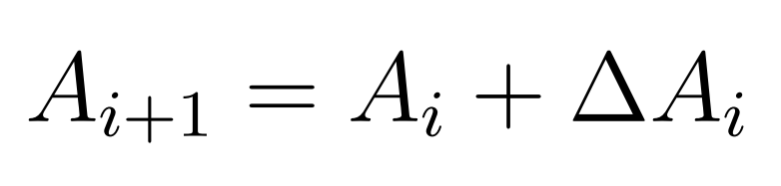
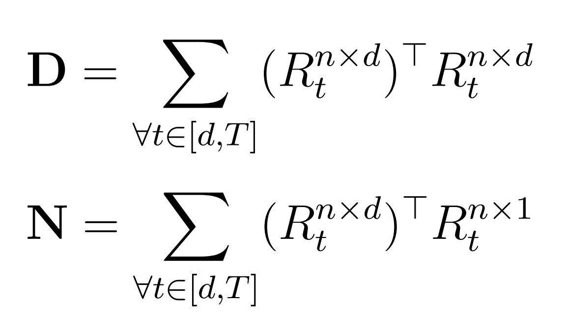
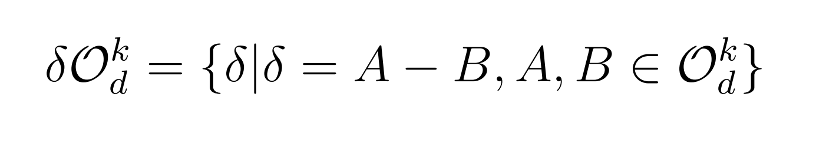
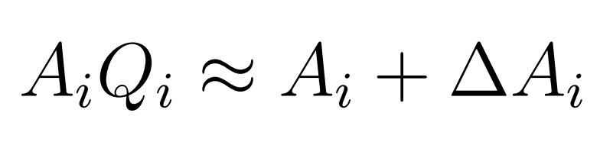
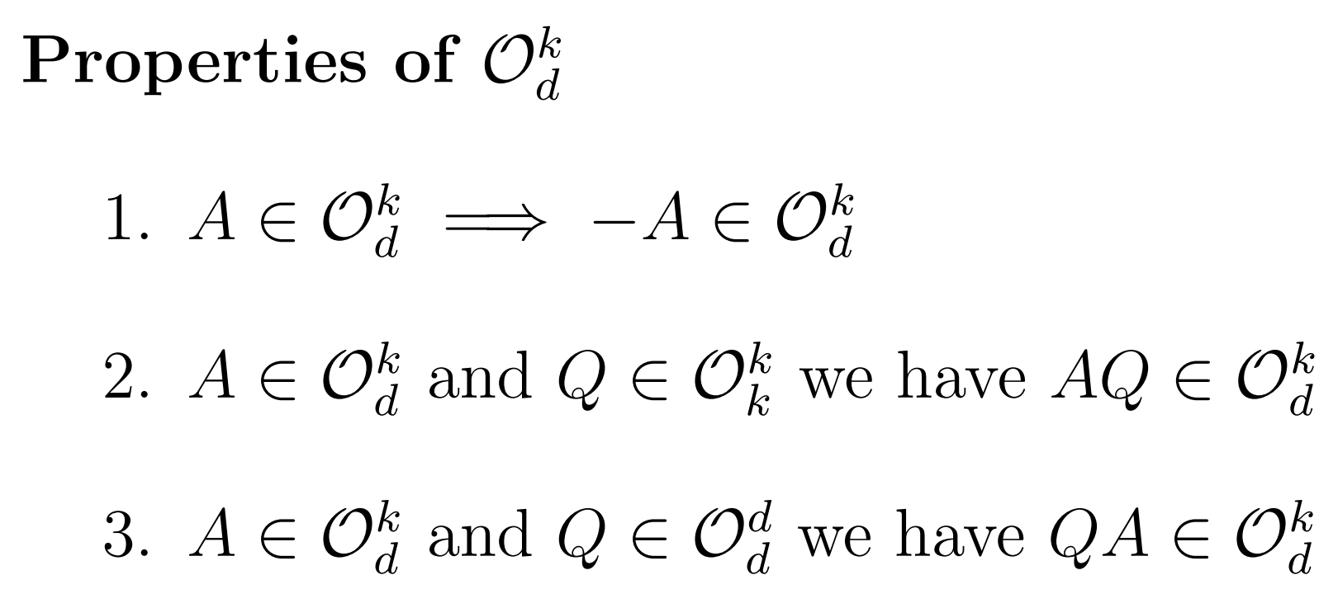
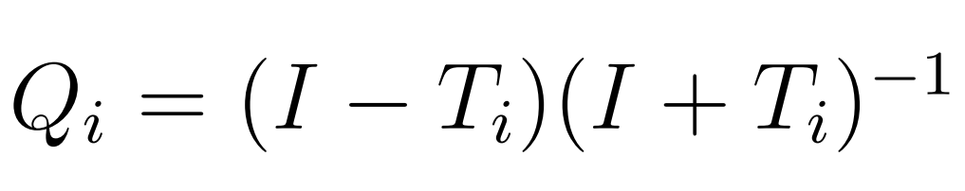
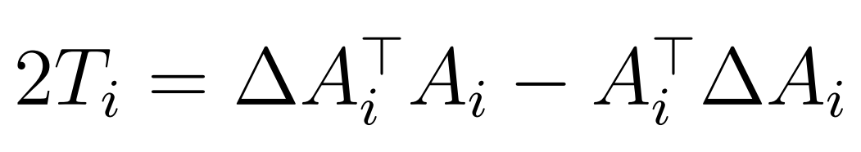
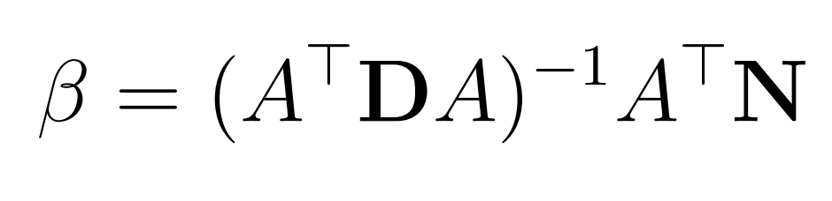
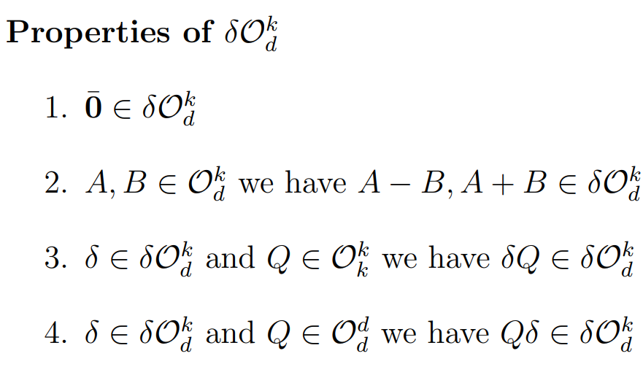
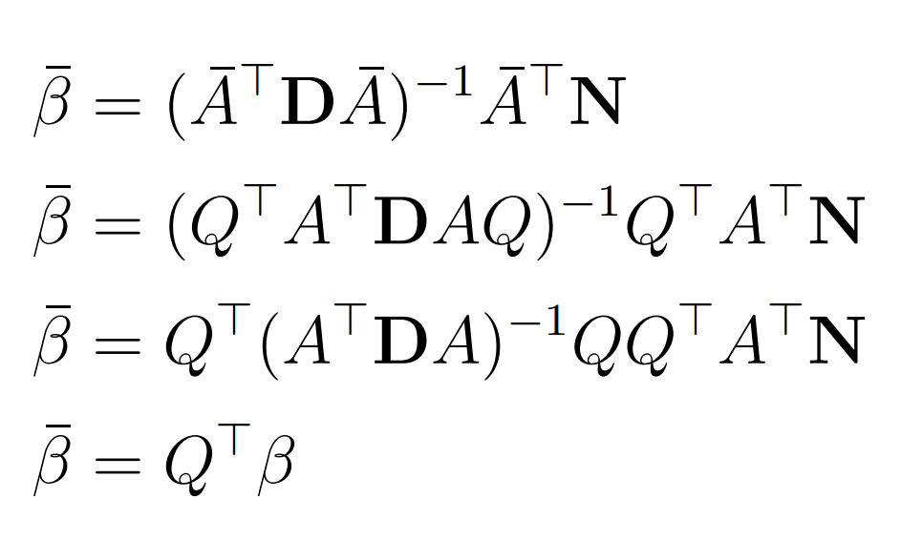
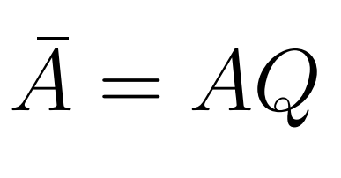
Motivation and Definition Literature Review
Addressing cond-fMOOP Observations and Methodology Experimental Results Conclusion and Future Work
Observations
Methodologies
Observations
Harshal Bharat Dupare, 18MA20015
Masters Thesis Project’s Presentation, 2nd May 2023

Slide 12
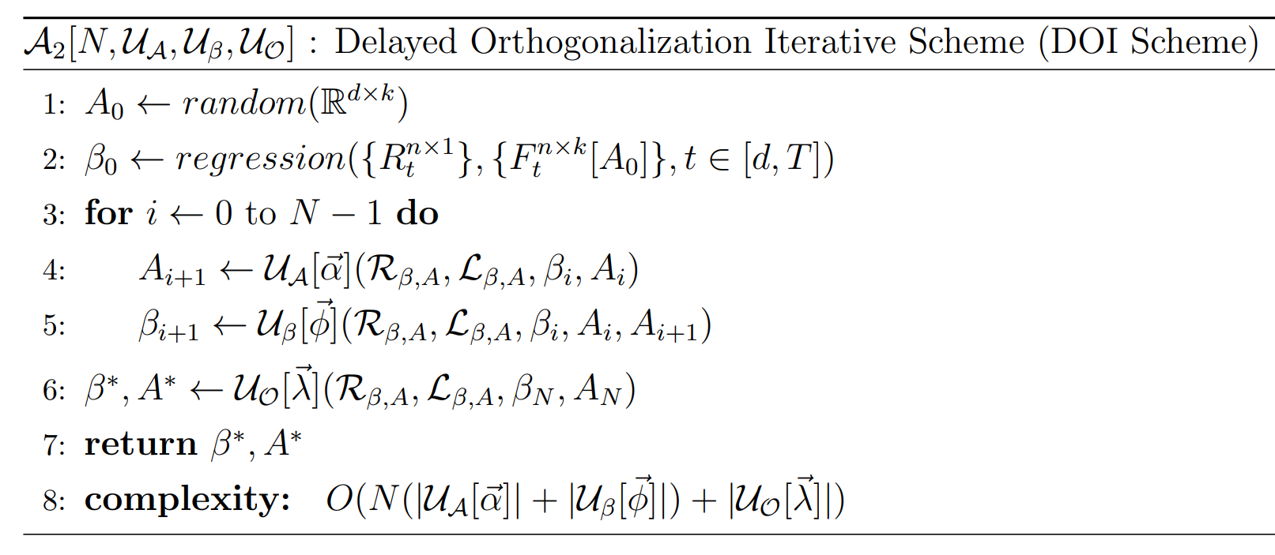
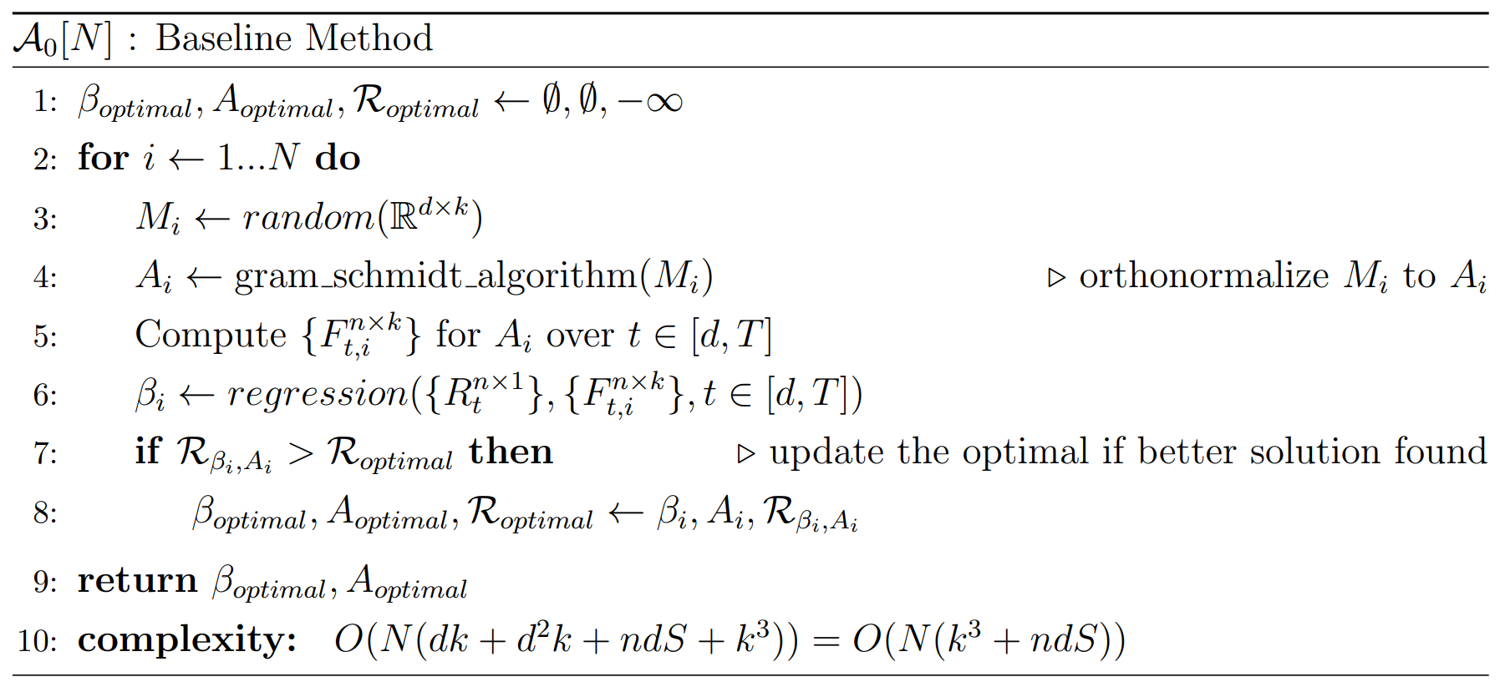
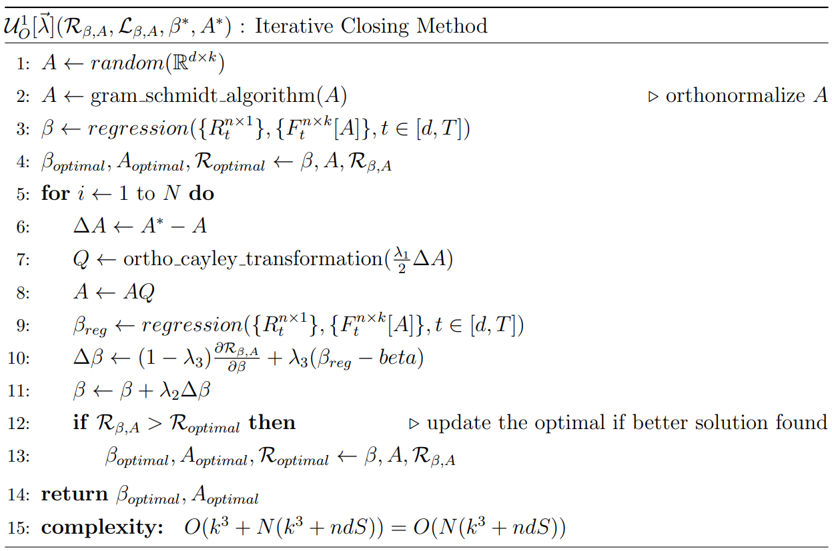
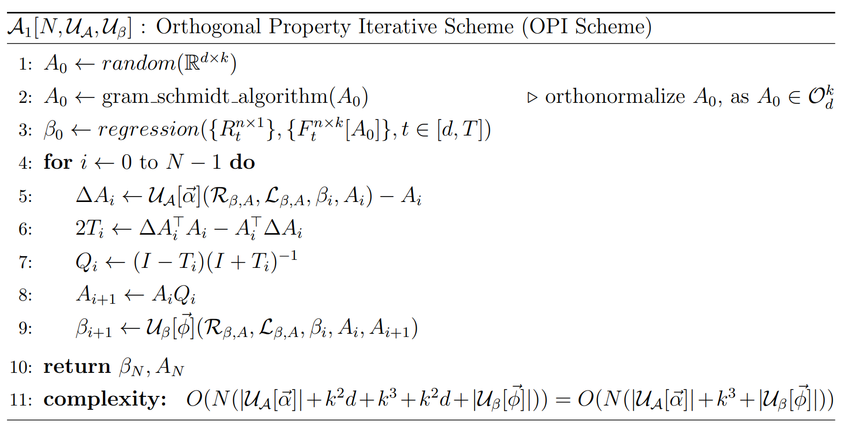
Motivation and Definition Literature Review
Addressing cond-fMOOP Observations and Methodology Experimental Results Conclusion and Future Work
Observations
Methodologies
Methodologies
Harshal Bharat Dupare, 18MA20015
Masters Thesis Project’s Presentation, 2nd May 2023

Slide 13
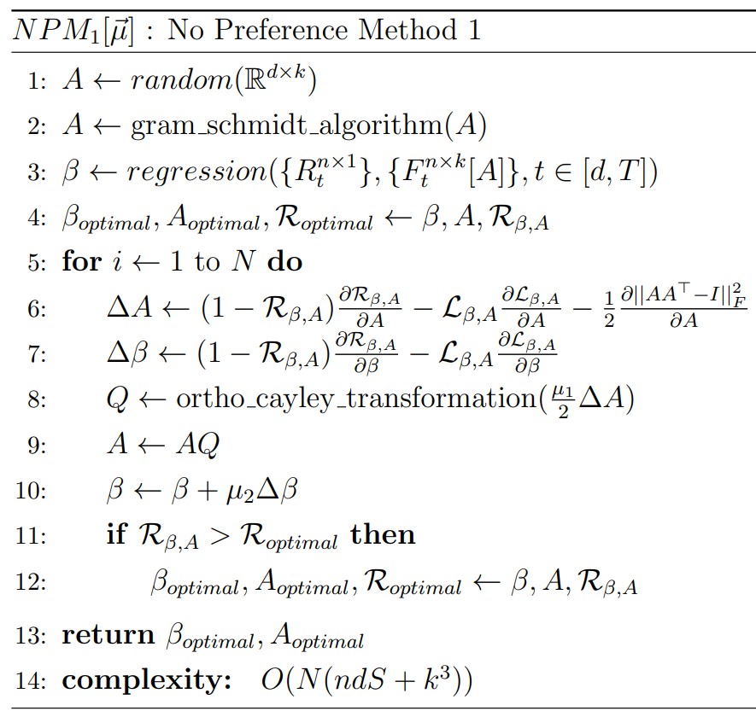
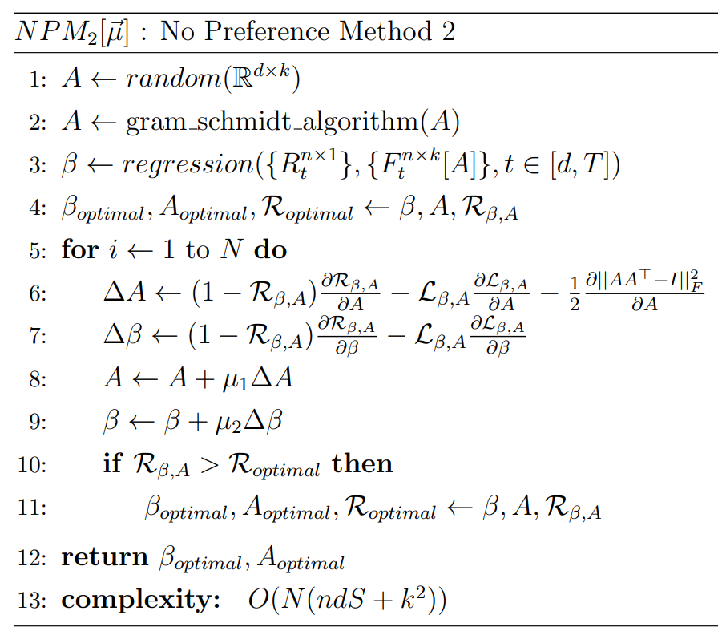
Motivation and Definition Literature Review
Addressing cond-fMOOP Observations and Methodology Experimental Results Conclusion and Future Work
Observations
Methodologies
Methodologies
Harshal Bharat Dupare, 18MA20015
Masters Thesis Project’s Presentation, 2nd May 2023

Slide 14
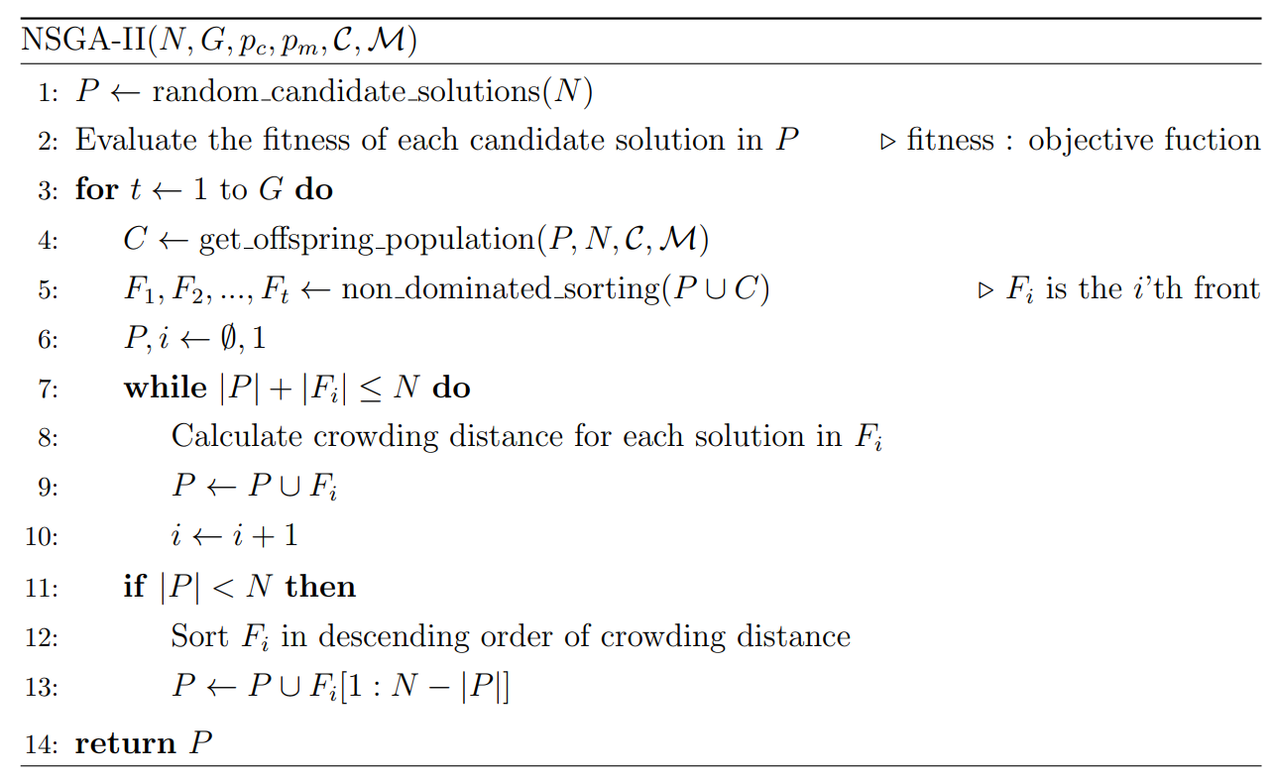
Motivation and Definition Literature Review
Addressing cond-fMOOP Observations and Methodology Experimental Results Conclusion and Future Work
Observations
Methodologies
Methodologies
Harshal Bharat Dupare, 18MA20015
Masters Thesis Project’s Presentation, 2nd May 2023

Slide 15
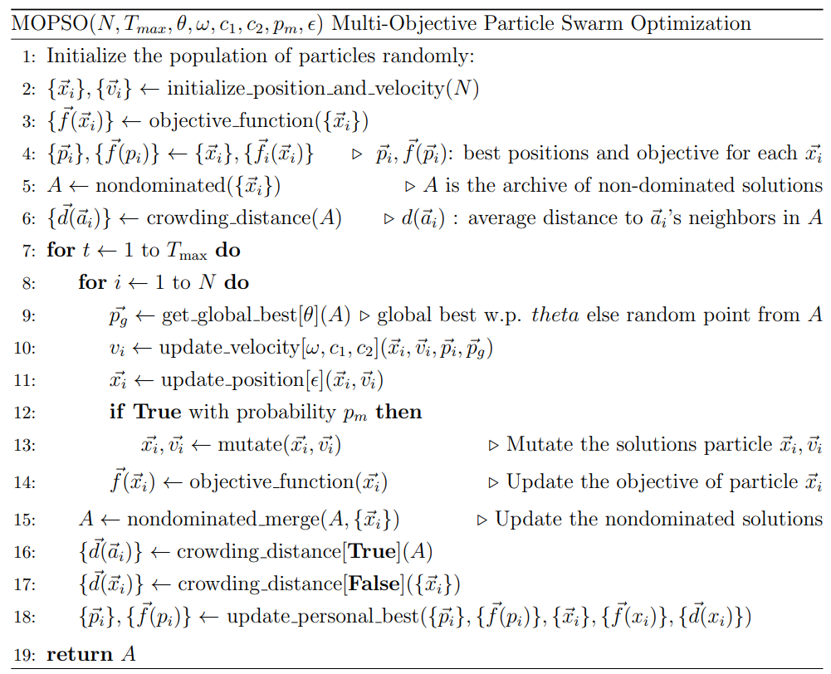
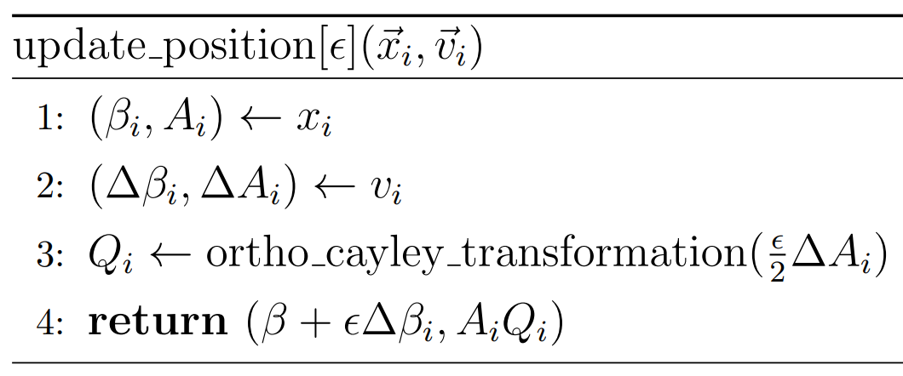
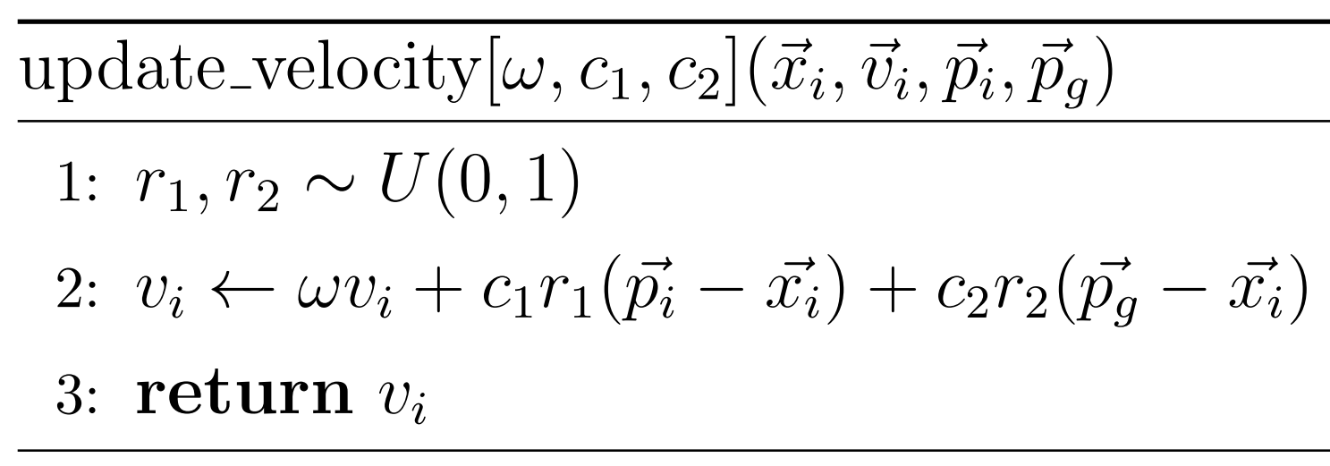
Motivation and Definition Literature Review
Addressing cond-fMOOP Observations and Methodology Experimental Results Conclusion and Future Work
Observations
Methodologies
Methodologies
Harshal Bharat Dupare, 18MA20015
Masters Thesis Project’s Presentation, 2nd May 2023

Slide 16
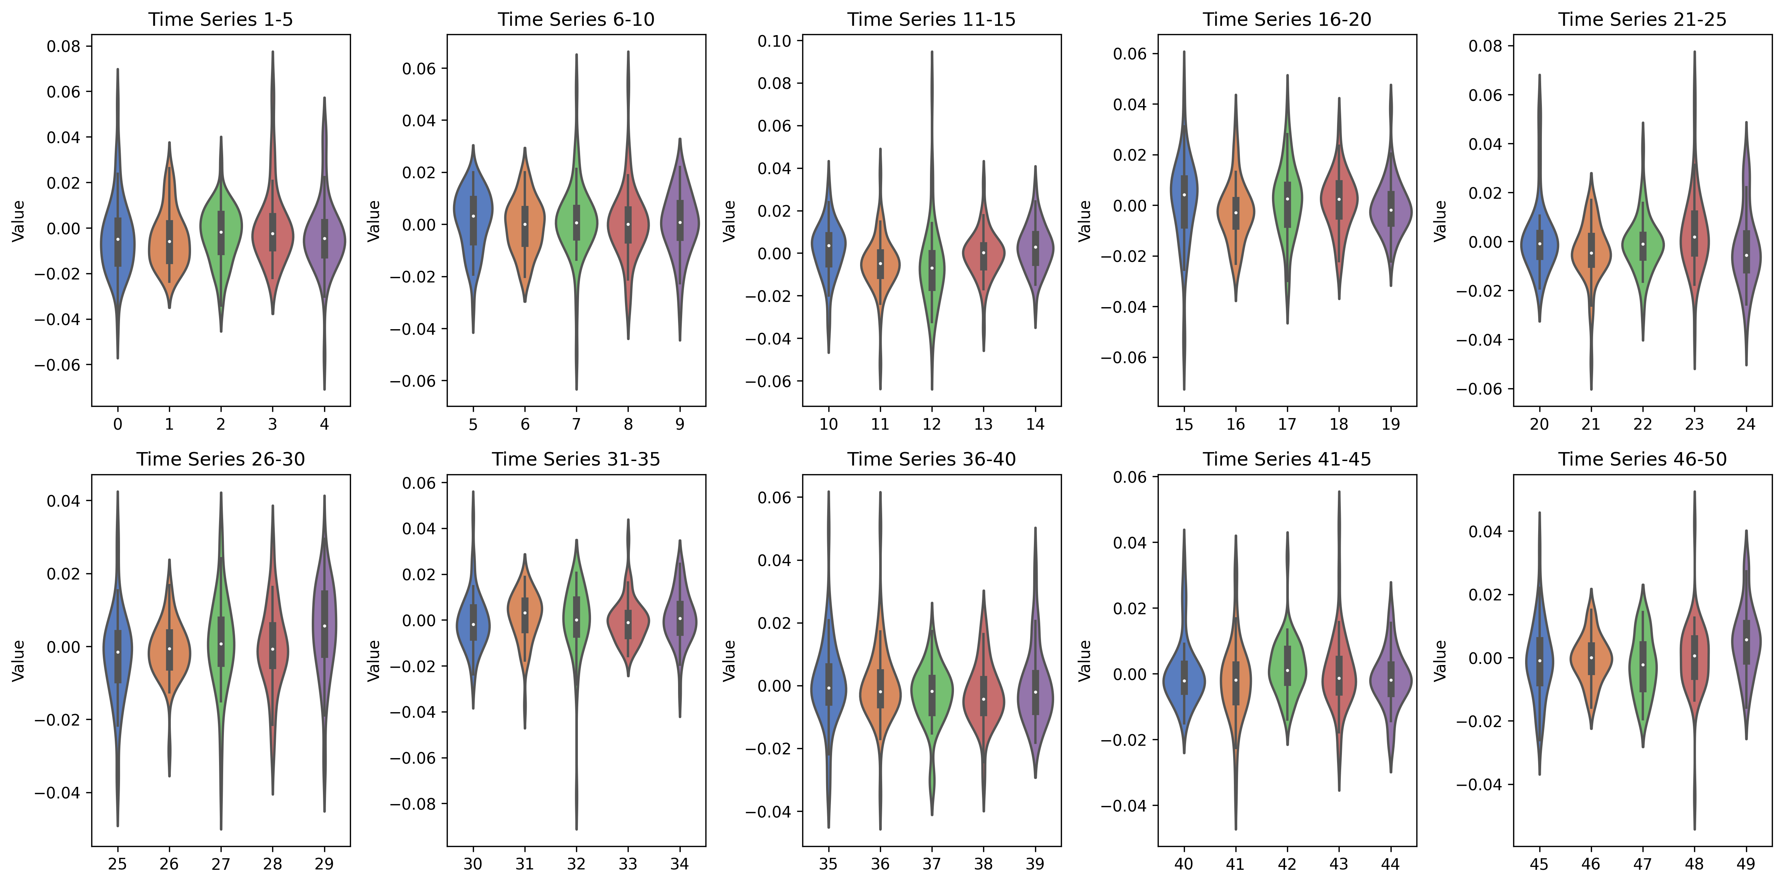
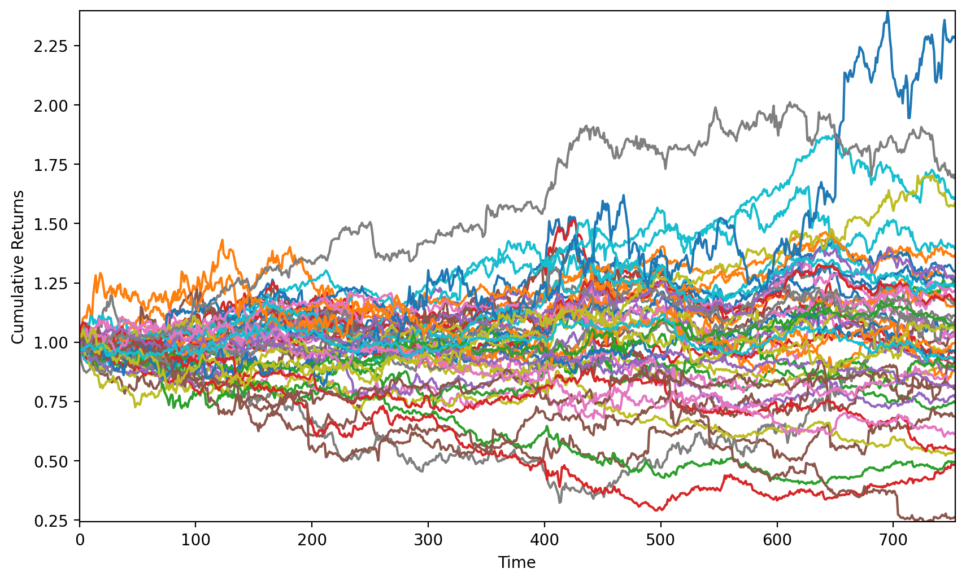
Motivation and Definition Literature Review
Addressing cond-fMOOP Observations and Methodology Experimental Results Conclusion and Future Work
Data
Results Visualization and Interpretation
Results Table and Discussion
Data
Time series returns data
For 50 time series
For 755 days
Data Source: Qube Research & Technologies (QRT) on the Challenge Data site.
Harshal Bharat Dupare, 18MA20015
Masters Thesis Project’s Presentation, 2nd May 2023

Slide 17
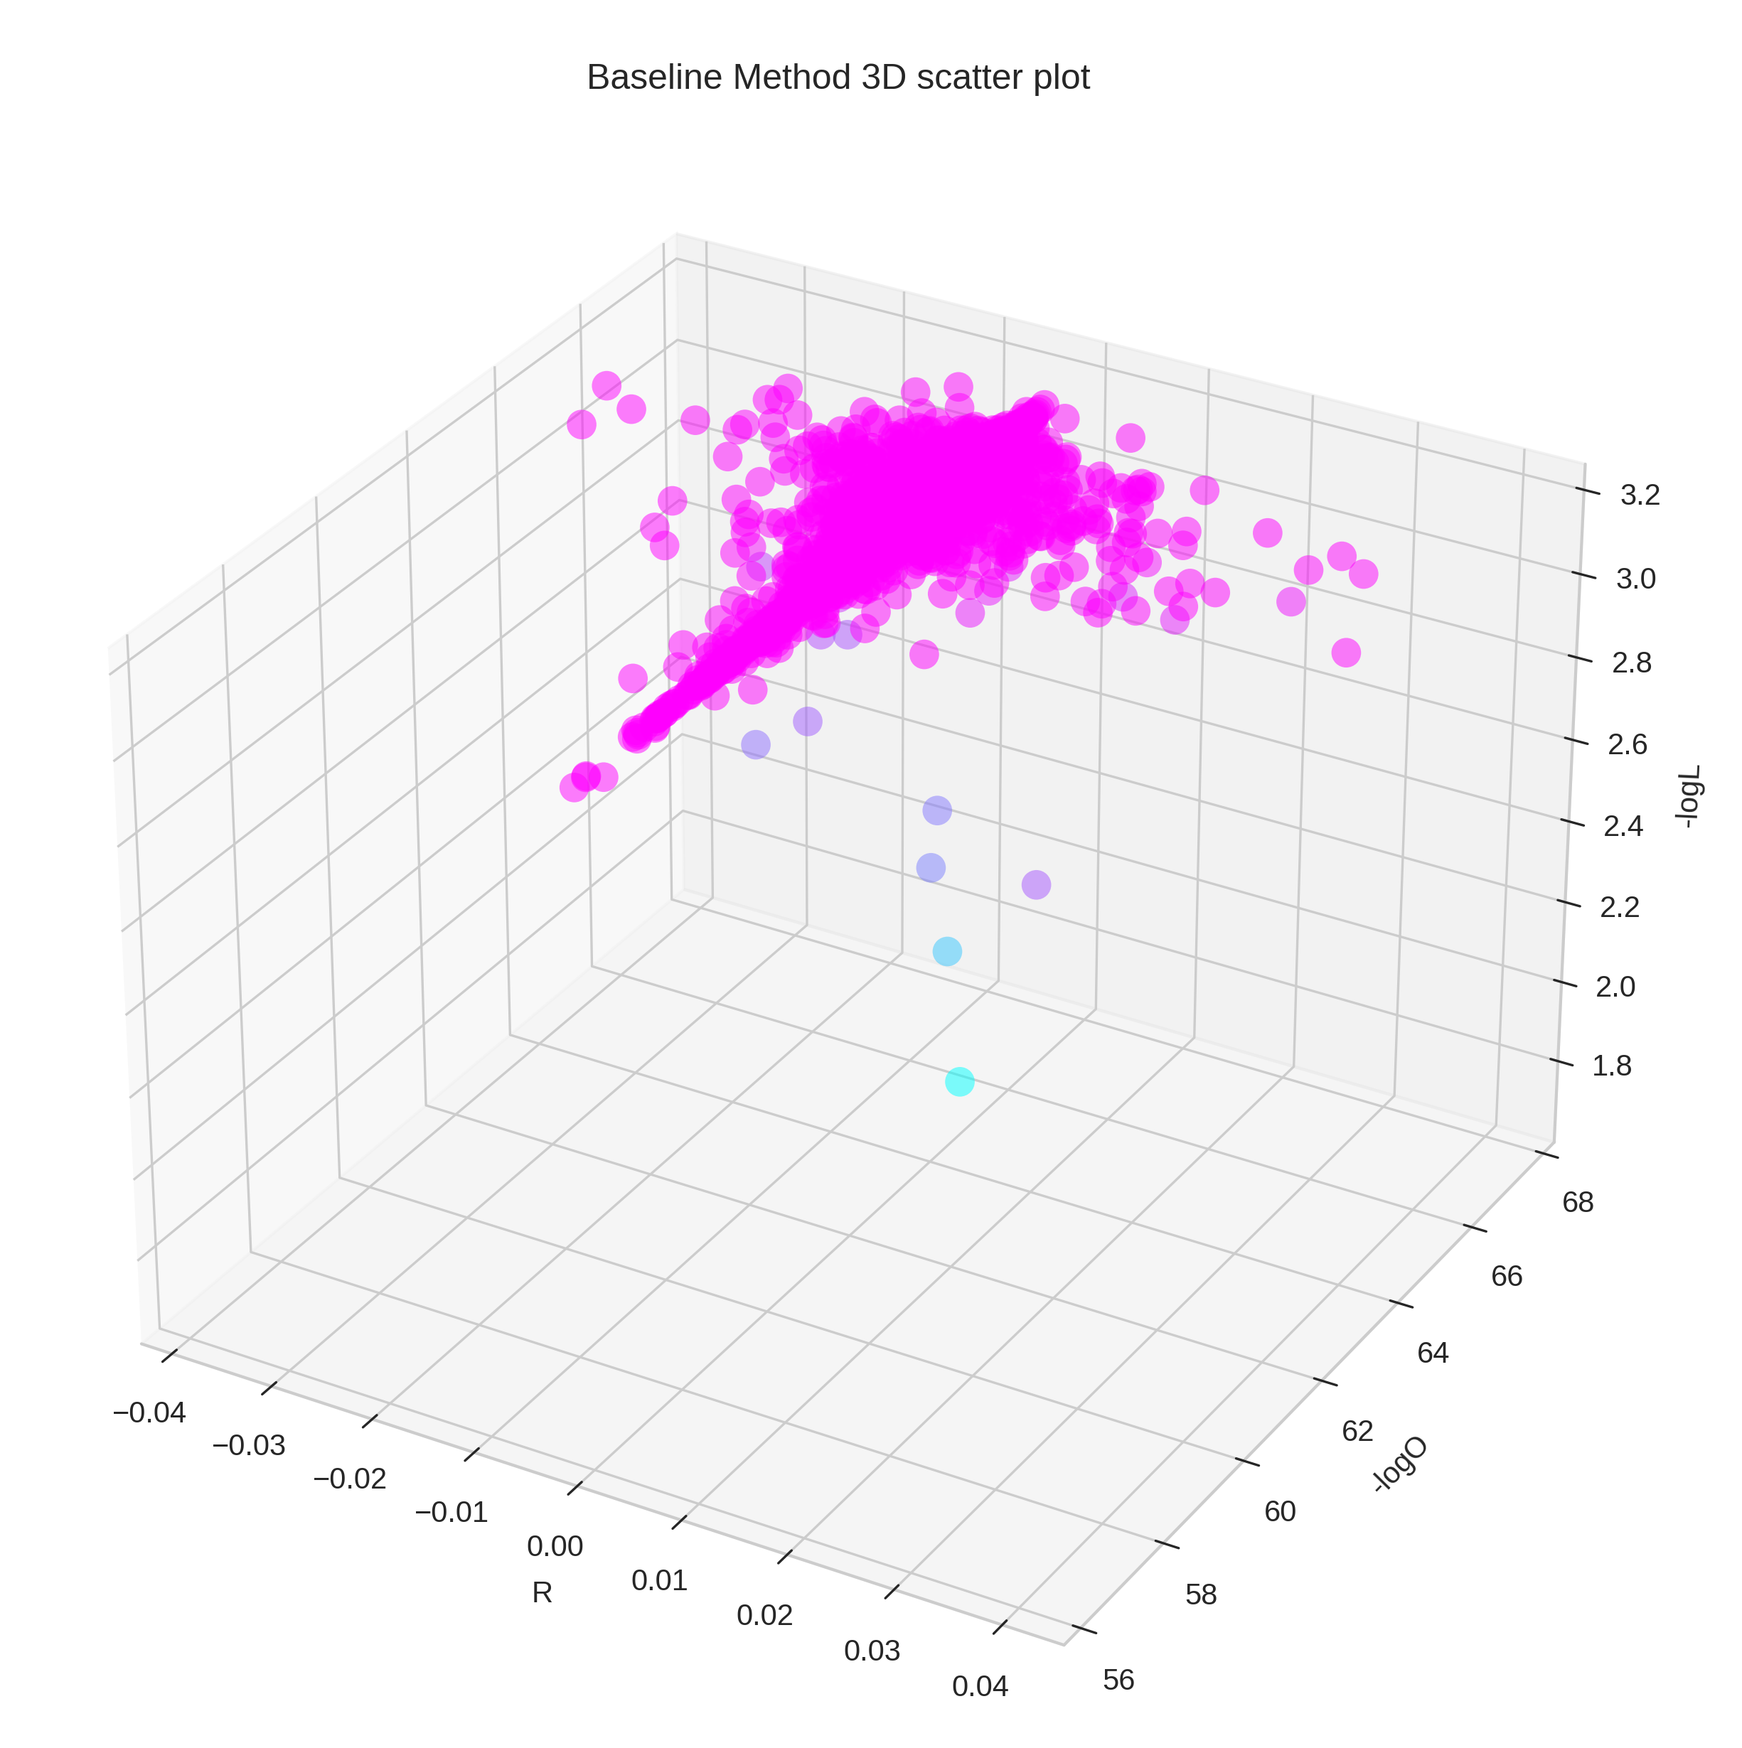
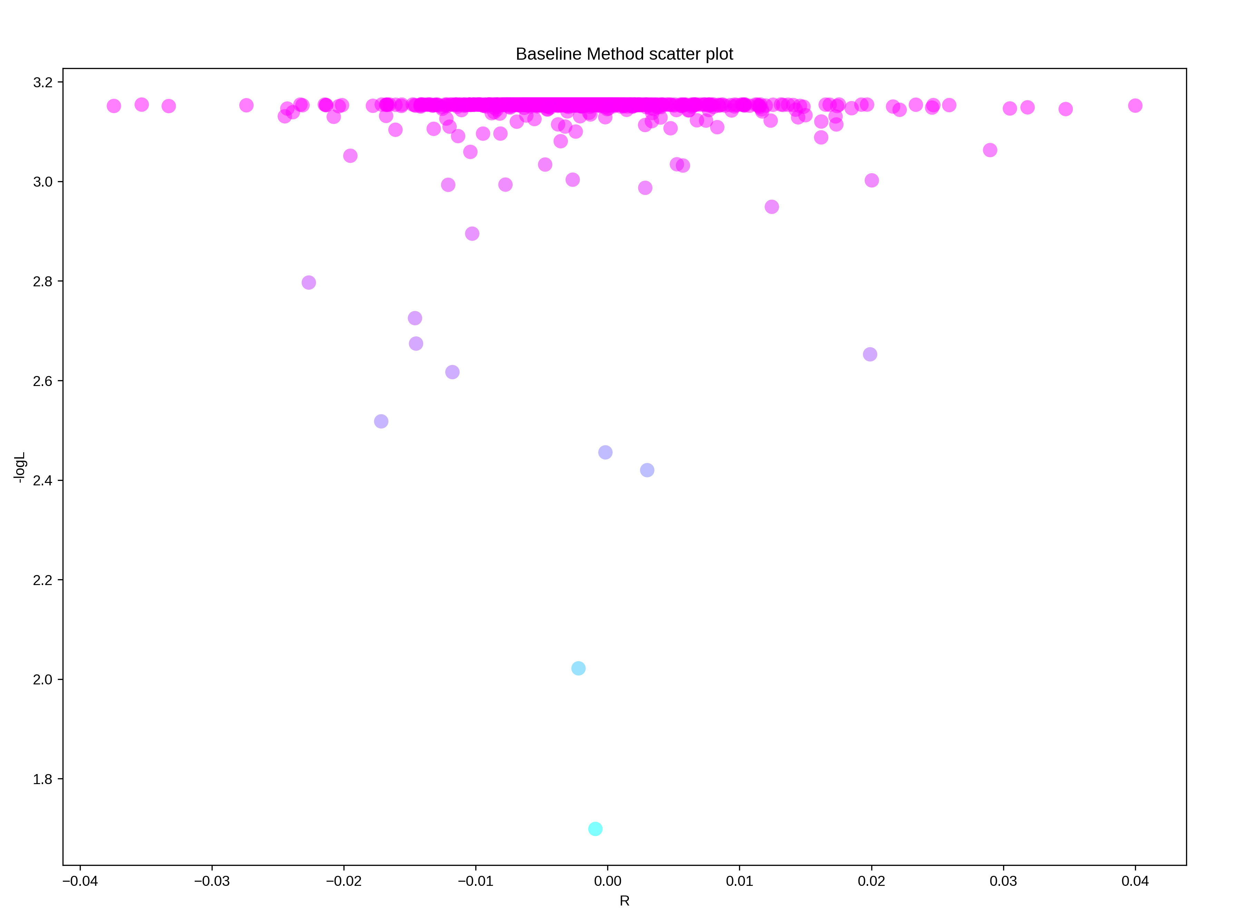
Motivation and Definition Literature Review
Addressing cond-fMOOP Observations and Methodology Experimental Results Conclusion and Future Work
Data
Results Visualization and Interpretation
Results Table and Discussion
Results Visualization and Interpretation
Harshal Bharat Dupare, 18MA20015
Masters Thesis Project’s Presentation, 2nd May 2023

Slide 18
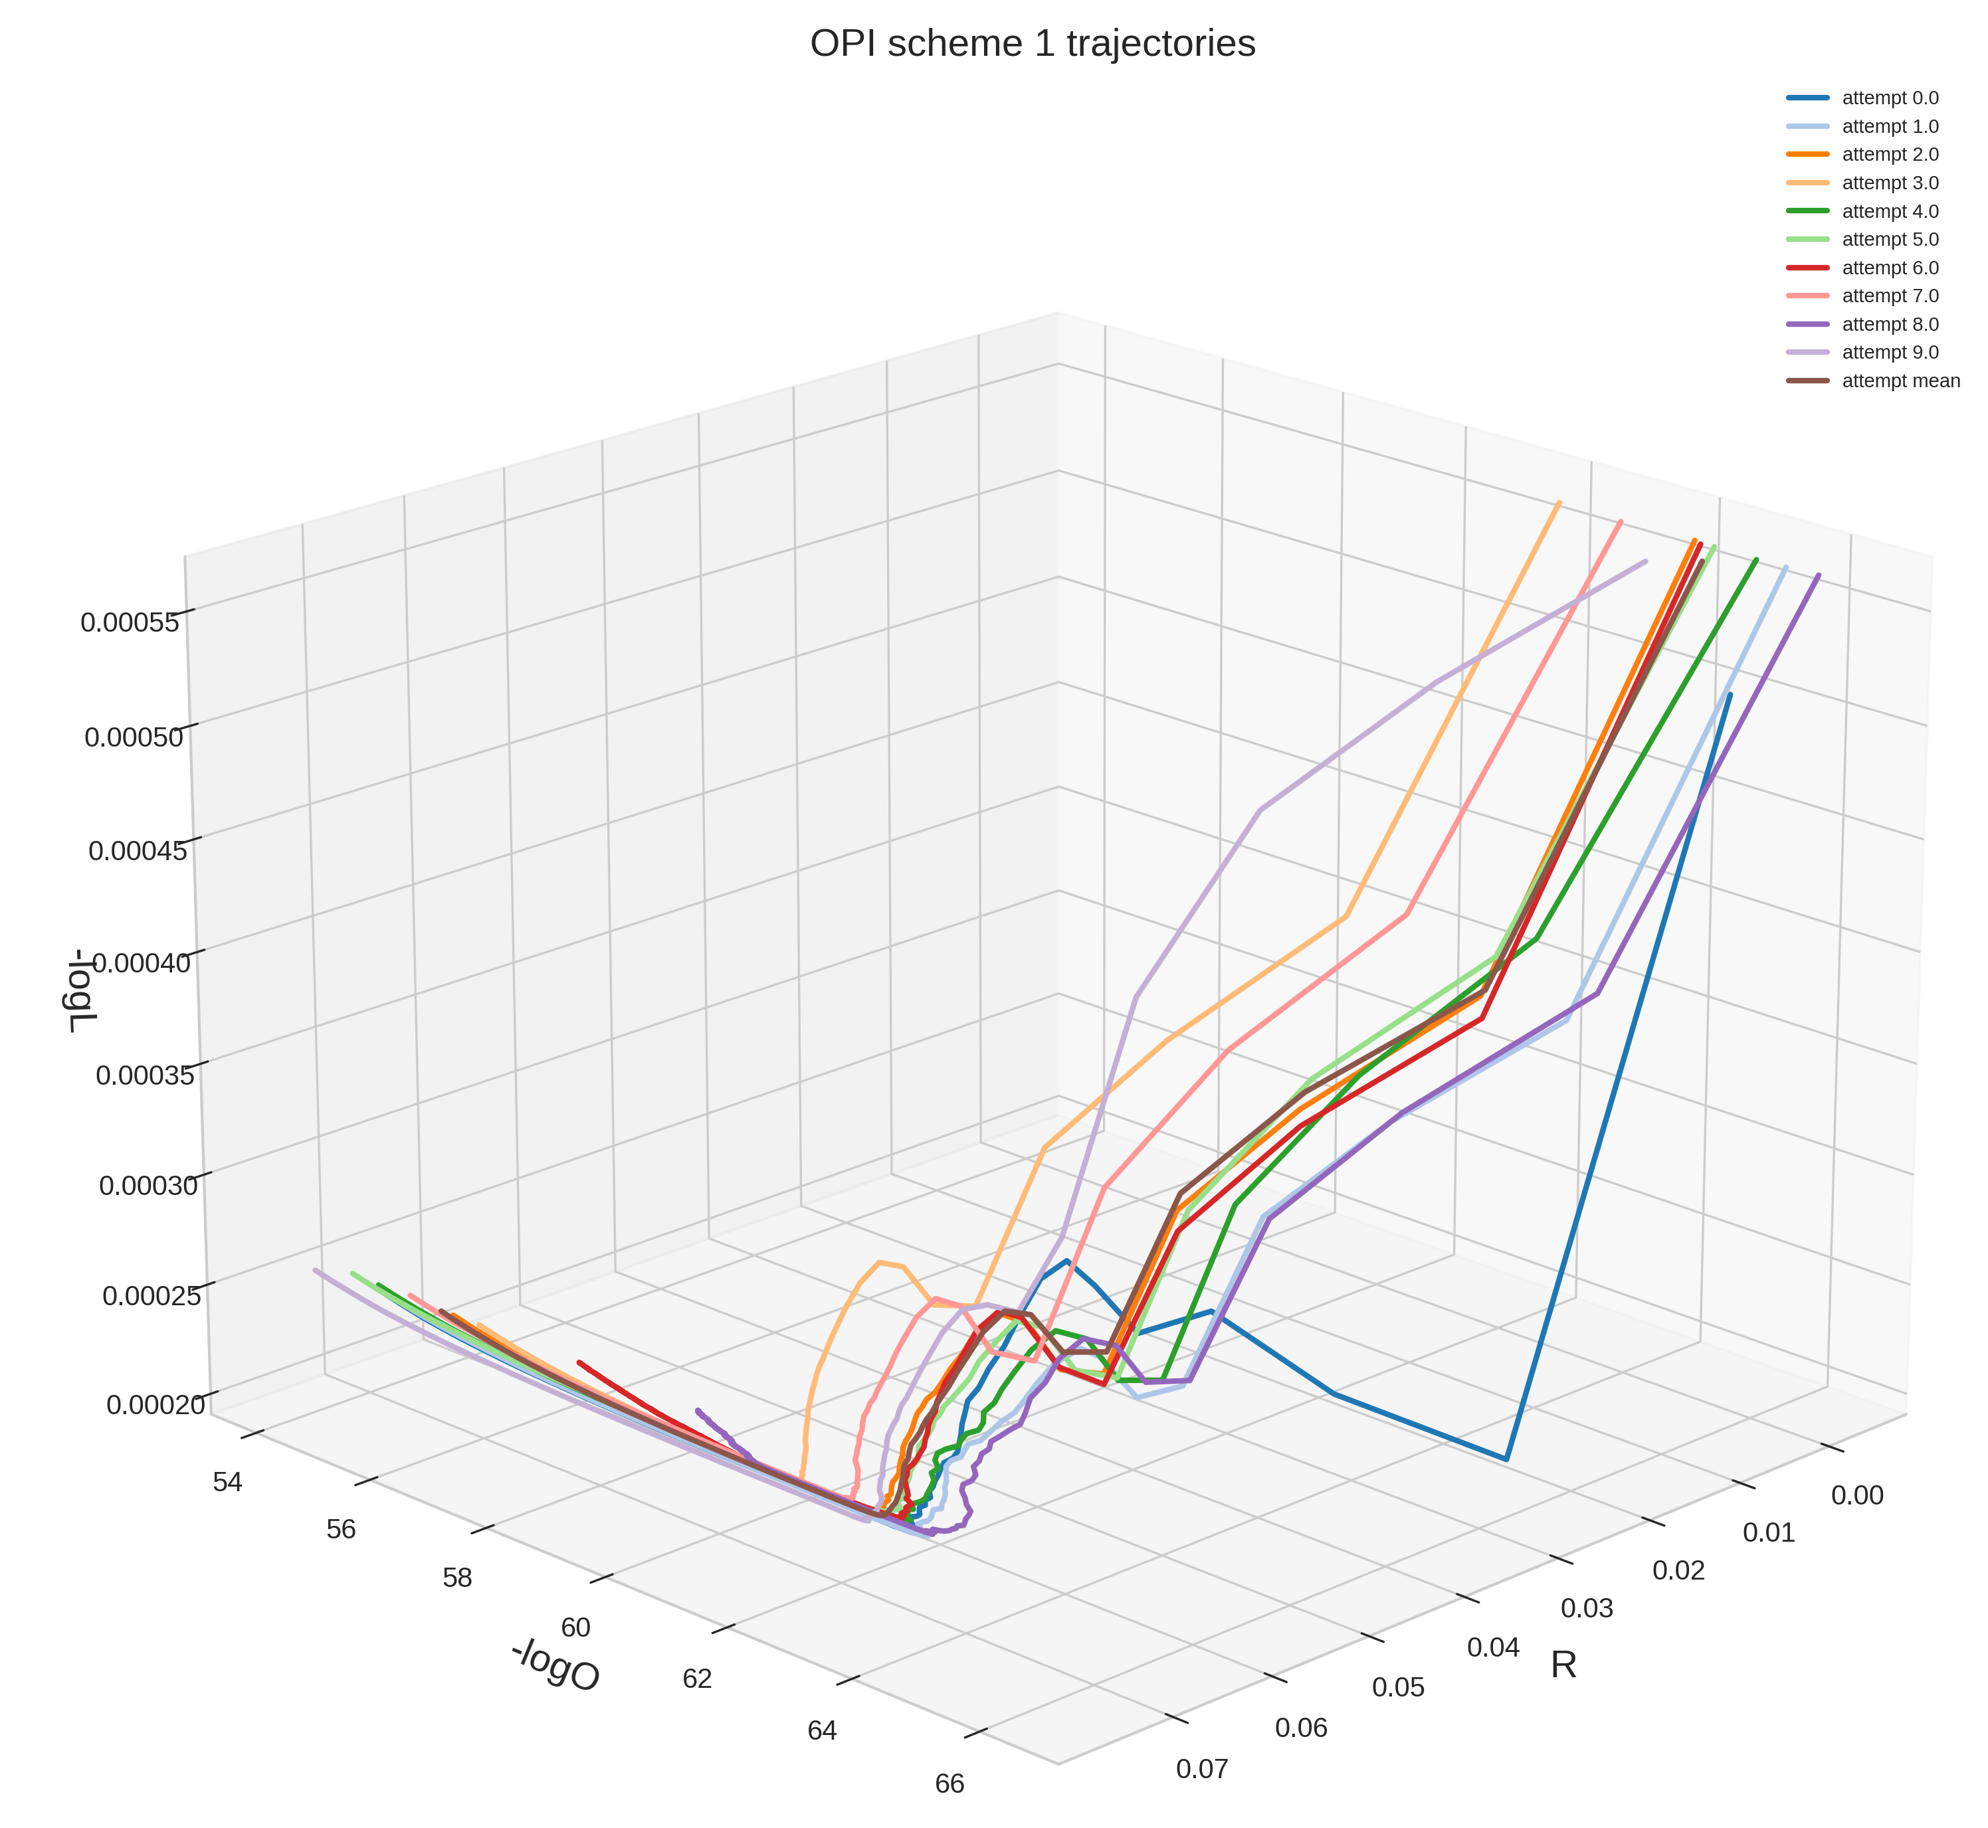

Motivation and Definition Literature Review
Addressing cond-fMOOP Observations and Methodology Experimental Results Conclusion and Future Work
Data
Results Visualization and Interpretation
Results Table and Discussion
Results Visualization and Interpretation
Harshal Bharat Dupare, 18MA20015
Masters Thesis Project’s Presentation, 2nd May 2023

Slide 19


Motivation and Definition Literature Review
Addressing cond-fMOOP Observations and Methodology Experimental Results Conclusion and Future Work
Data
Results Visualization and Interpretation
Results Table and Discussion
Results Visualization and Interpretation
Harshal Bharat Dupare, 18MA20015
Masters Thesis Project’s Presentation, 2nd May 2023

Slide 20


Motivation and Definition Literature Review
Addressing cond-fMOOP Observations and Methodology Experimental Results Conclusion and Future Work
Data
Results Visualization and Interpretation
Results Table and Discussion
Results Visualization and Interpretation
Harshal Bharat Dupare, 18MA20015
Masters Thesis Project’s Presentation, 2nd May 2023

Slide 21


Motivation and Definition Literature Review
Addressing cond-fMOOP Observations and Methodology Experimental Results Conclusion and Future Work
Data
Results Visualization and Interpretation
Results Table and Discussion
Results Visualization and Interpretation
Harshal Bharat Dupare, 18MA20015
Masters Thesis Project’s Presentation, 2nd May 2023

Slide 22


Motivation and Definition Literature Review
Addressing cond-fMOOP Observations and Methodology Experimental Results Conclusion and Future Work
Data
Results Visualization and Interpretation
Results Table and Discussion
Results Visualization and Interpretation
Harshal Bharat Dupare, 18MA20015
Masters Thesis Project’s Presentation, 2nd May 2023

Slide 23


Motivation and Definition Literature Review
Addressing cond-fMOOP Observations and Methodology Experimental Results Conclusion and Future Work
Data
Results Visualization and Interpretation
Results Table and Discussion
Results Visualization and Interpretation
Harshal Bharat Dupare, 18MA20015
Masters Thesis Project’s Presentation, 2nd May 2023

Slide 24


Motivation and Definition Literature Review
Addressing cond-fMOOP Observations and Methodology Experimental Results Conclusion and Future Work
Data
Results Visualization and Interpretation
Results Table and Discussion
Results Visualization and Interpretation
Harshal Bharat Dupare, 18MA20015
Masters Thesis Project’s Presentation, 2nd May 2023

Slide 25

Motivation and Definition Literature Review
Addressing cond-fMOOP Observations and Methodology Experimental Results Conclusion and Future Work
Data
Results Visualization and Interpretation
Results Table and Discussion
Results Visualization and Interpretation
Harshal Bharat Dupare, 18MA20015
Masters Thesis Project’s Presentation, 2nd May 2023

Slide 26












Motivation and Definition Literature Review
Addressing cond-fMOOP Observations and Methodology Experimental Results Conclusion and Future Work
Data
Results Visualization and Interpretation
Results Table and Discussion
Results Visualization and Interpretation (Backup)
Harshal Bharat Dupare, 18MA20015
Masters Thesis Project’s Presentation, 2nd May 2023

Slide 27

Motivation and Definition Literature Review
Addressing cond-fMOOP Observations and Methodology Experimental Results Conclusion and Future Work
Data
Results Visualization and Interpretation
Results Table and Discussion
Results Table and Discussion
max achieved in R
not 50% for some
low std is better
EA methods
latter decimals
smaller: cause R?
DOI
Harshal Bharat Dupare, 18MA20015
Masters Thesis Project’s Presentation, 2nd May 2023

Slide 28

Motivation and Definition Literature Review
Addressing cond-fMOOP Observations and Methodology Experimental Results Conclusion and Future Work
Conclusion
Future Works
Conclusion
Defined cond-fMOOP
Reviewed various methods to solve MOOP
Applications of this formulation for Neural Networks
Formulated critical question about cond-fMOOP
Relations between cond-fMOOP and $L_{2}$ regularization
Observed properties of original problem
Used them to extend various methods
Implemented those methods
Derived Insights from those results
Noted the advantages of using the Derived Properties.
Harshal Bharat Dupare, 18MA20015
Masters Thesis Project’s Presentation, 2nd May 2023

Slide 29
Motivation and Definition Literature Review
Addressing cond-fMOOP Observations and Methodology Experimental Results Conclusion and Future Work
Conclusion
Future Works
Future Works
Studies to determine problems in the cond-fMOOP category
Develop a class of methods to address the cond-fMOOP problem
Address any of the three critical questions
Explore other properties formulations of the loss and reward functions to optimize computation of solutions
Explore other potential applications of the presented methods beyond the Linear Factor Model problem
Harshal Bharat Dupare, 18MA20015
Masters Thesis Project’s Presentation, 2nd May 2023

Slide 30
Thank You
You can find all the
Report LaTeX files
Images
Python Code
On my github
Link: harshal-dupare/masters_thesis_project: Masters Thesis Project, Mathematics Department, IIT Kharagpur (github.com)
Url: https://github.com/harshal-dupare/masters_thesis_project
Harshal Bharat Dupare, 18MA20015
Masters Thesis Project’s Presentation, 2nd May 2023

